Slide 1



INSTAGRAM USER ANALYTICS
SQL Fundamentals
by Nazireen Sania

Slide 2
OVERVIEW
Project Description
Insights
Approach
Result
Tech-Stack Used

Slide 3
PROJECT DESCRIPTION
The project consists of creating a database named ‘ig_clone’ consisting of seven tables namely - comments, follows, likes, photo_tags, photos, tags and users. Each table has few columns containing data, for example, the table comments consist of the columns – id, comment_text, user_id, photo_id, and created_at which contain the data about the user id, the respective comment by the user when it was created.
The aim of the project is to perform two main analysis, i.e, (A) Marketing Analysis and (B) Investor Metrics. User analysis involves tracking how users engage with a digital product, such as a software application or a mobile app. The marketing Analysis can be used by the marketing tesm to award loyal customers and the Investor Metrics can be used by investors to boost engagement.

Slide 4
APPROACH
In order to analyse the database, it is essential to keep the steps simple, following a direct approach. After reading the task instructions, I studied the datset and installed MySQL Wokbench, following the instructions. First, we crete the database and the tables with their respective columns and entries. Next, we identify common columns in each table and the relationship between others.

Slide 5
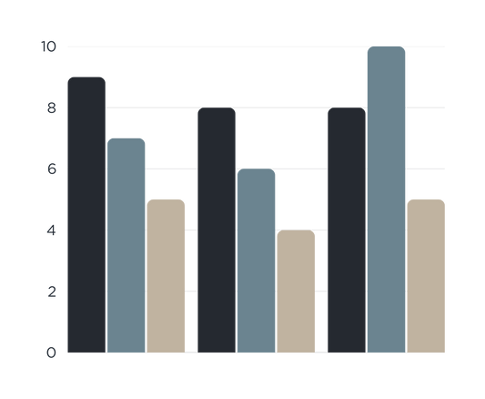

TECH STACK USED
We use the MySQL Workbench for this project for the following reasons:
It has a user-friendly interface where we can write and run SQL queries easily.
We can see tables, relationships, and how data is connected, making it easier to understand.
We can quickly test our SQL queries and fix errors if needed.
It displays query results in a neat table format, making analysis simple.
Since our project is in MySQL, Workbench is the best tool because it’s built for this database.
We can take screenshots of queries and results for documentation.
.

Slide 6
INSIGHTS
The project involves two main analysis:
Marketing Analysis
Investor Metrics
Loyal User Reward
Inactive User Engagement
Contest Winner Declaration
Hashtag Research
Ad Campaign Launch
User Engagement
Bots & Fake Accounts

Slide 7
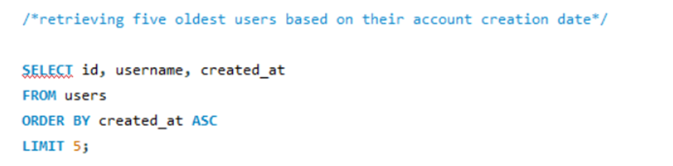
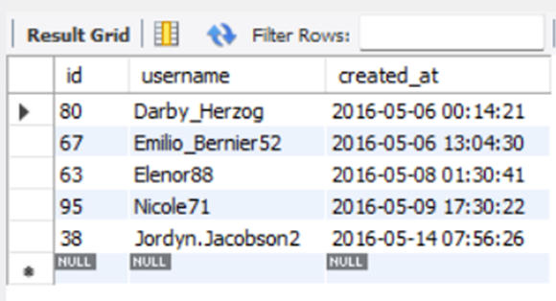
(A) MARKETING ANALYSIS
﻿1. Loyal User Reward: Five Oldest Users
This retrieves the five oldest users based on their account creation date.

Slide 8
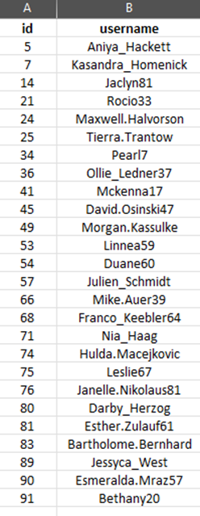
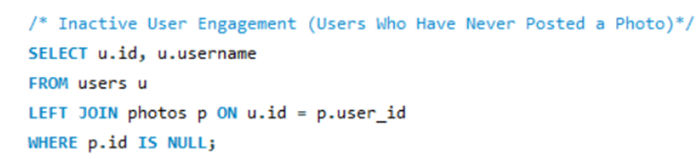
(A) MARKETING ANALYSIS
﻿2. Inactive User Engagement Users Who Have Never Posted a Photo
This finds users who do not have any associated photos.

Slide 9
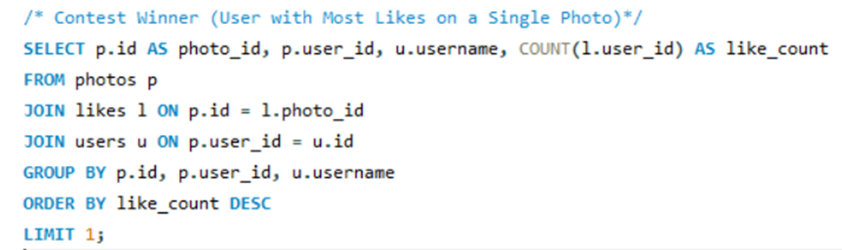
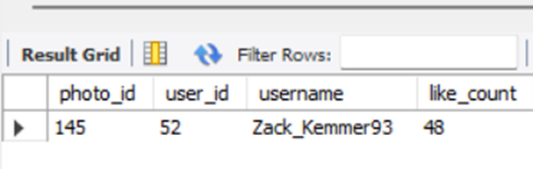
(A) MARKETING ANALYSIS
﻿3. Contest Winner : User with Most Likes on a Single Photo
This identifies the photo with the most likes and provides the user's details.

Slide 10
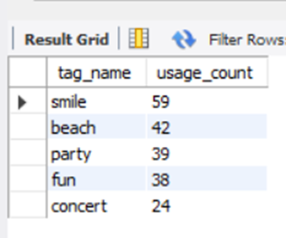
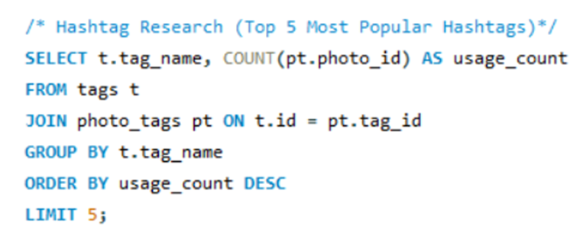
(A) MARKETING ANALYSIS
﻿4. Hashtag Research : Top 5 Most Popular Hashtags
This retrieves the top 5 most frequently used hashtags.

Slide 11
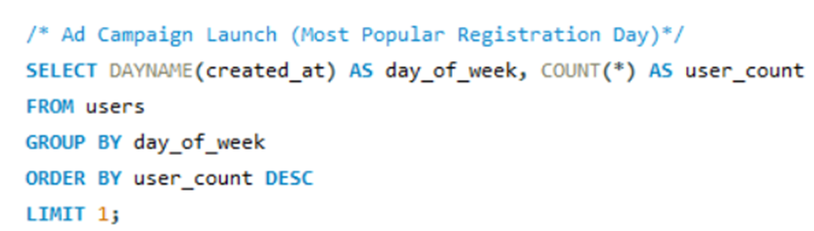
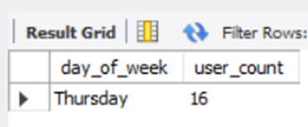
(A) MARKETING ANALYSIS
5. ﻿Ad Campaign Launch : Most Popular Registration Day
This determines the day when most users registered, helping decide the best ad campaign timing.

Slide 12
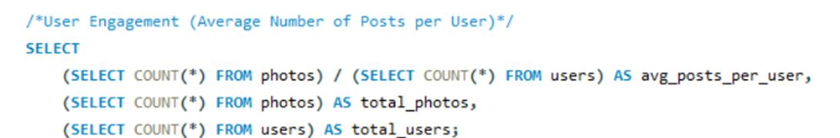
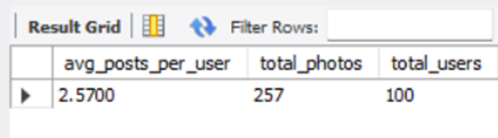
(A) INVESTOR METRICS
﻿1. User Engagement : Average Number of Posts per User
This calculates the average number of posts per user and the total number of photos divided by users.

Slide 13
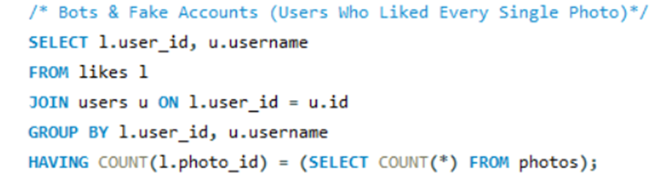
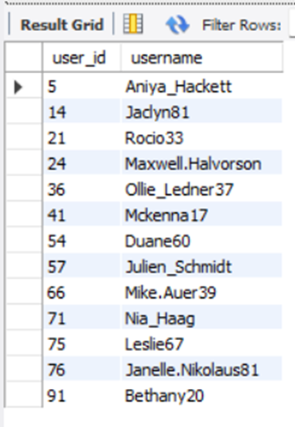
(A) INVESTOR METRICS
2. Bots & Fake Accounts : Users Who Liked Every Single Photo
This finds users who have liked every single photo, a potential indicator of bot behavior.

Slide 14
RESULTS
1. User Activity Overview
The total number of users in the database is 100.
The oldest user in the dataset is Darby_Herzog.
There are 13 bot and fake accounts and 26 inactive users.
2. Post Engagement Statistics
The average posts per user is 2.5700 and the total number of posts by all the users is 257.
The most liked post is from User Zack_Kemmer93, with 48 likes.
3. Top Hashtags and Their Usage
The most used hashtag in the dataset is #smile, appearing 59 times.
Other popular hashtags include #beach, #party, #fun and #concert.

Slide 15
Thank You

